Slide 1





SPORTS EQUIPMENT MANAGEMENT
Presented by Batch-05

Slide 2


Introduction
THE SPORTS EQUIPMENT MANAGEMENT SYSTEM IS DIVIDED INTO SEVERAL KEY MODULES, EACH DESIGNED TO HANDLE A SPECIFIC FUNCTION. THESE MODULES WORK TOGETHER TO PROVIDE A SMOOTH AND EFFICIENT EXPERIENCE FOR STUDENTS, FACULTY, AND ADMINISTRATORS.
•✔ Student Registration
•✔ Equipment Request System
•✔ Faculty Approval
•✔ Real-time Inventory Management

Slide 3

Our Team
Rama Krishna
---------------
231FA04603
Sujith Sai
---------------
231FA04625
Sai Chandh
---------------
231FA04672
Ganesh
---------------
231FA04680
Bhagya Lakshmi
----------------
231FA04733

Slide 4
Project Goals
To simplify and digitize the process of sports equipment requests and approvals for students and faculty.
To ensure effective tracking and management of equipment usage, returns, and conditions.
To promote accountability and transparency through a structured, user-friendly platform.

Slide 5
Problems
1
2
How can we ensure accountability to prevent the loss or damage of sports equipment
How can we reduce delays and confusion in the sports equipment request and allocation process

Slide 6
Process
1
2
3
STUDENT REGISTRATION
EQUIPMENT REQUEST
FACULTY APPROVAL
Students enter their details and verify their registration number.
Students can request
available sports equipment
with a single click
Faculty members verify requests and approve
or deny them

Slide 7
Process
4
5
INVENTORY MANAGEMENT
USER INTERFACE
Real-time update of equipment availability after approval.
Simple and clean design
for easy navigation
and usability.

Slide 8
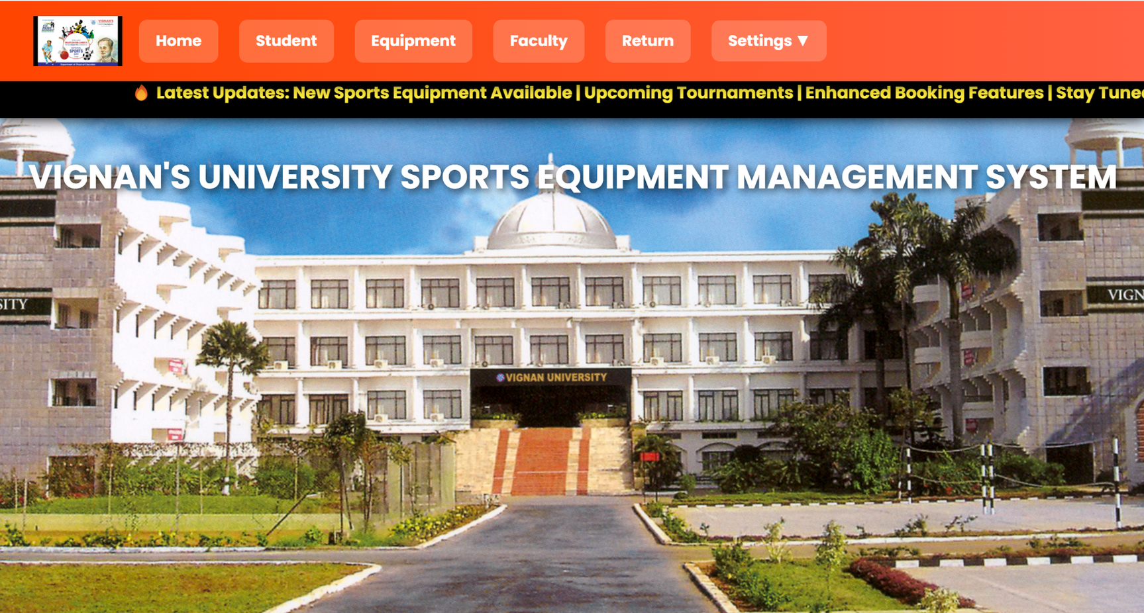
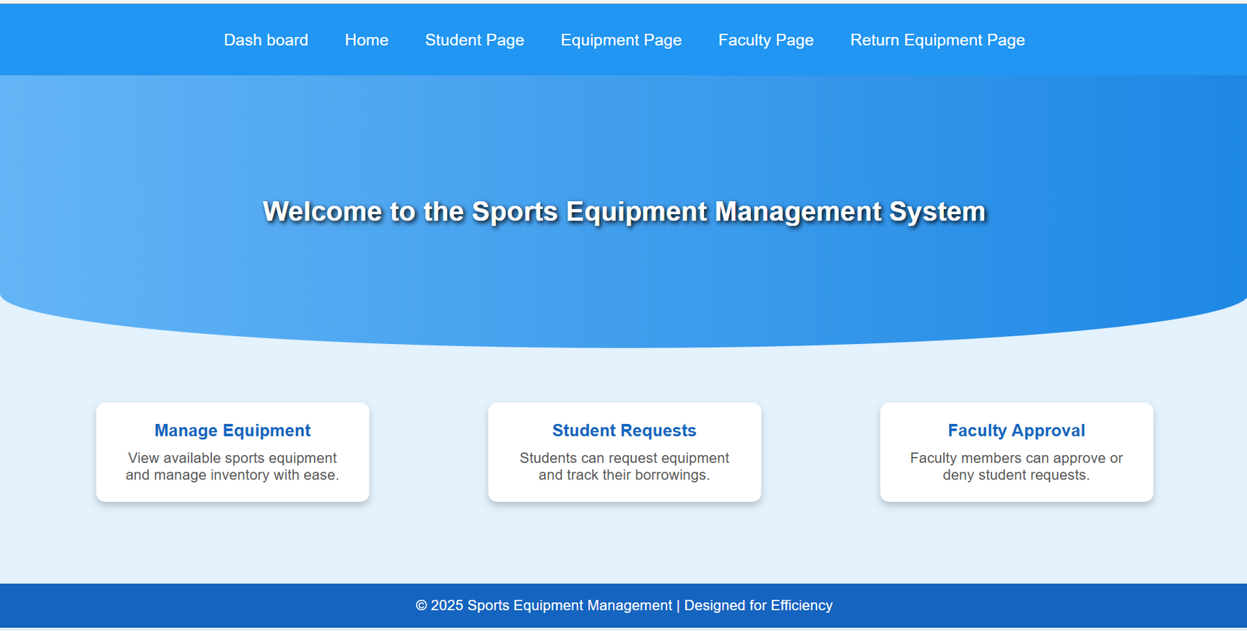
PROJECT PROTOTYPE
INDEX
HOME

Slide 9
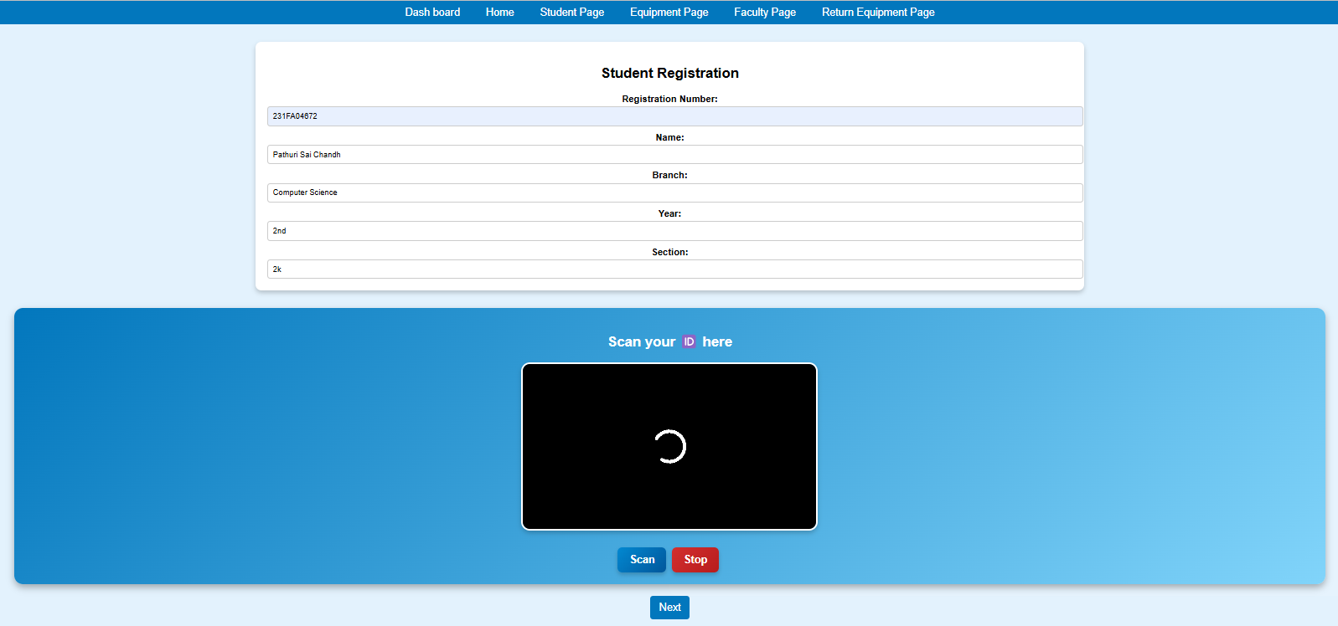
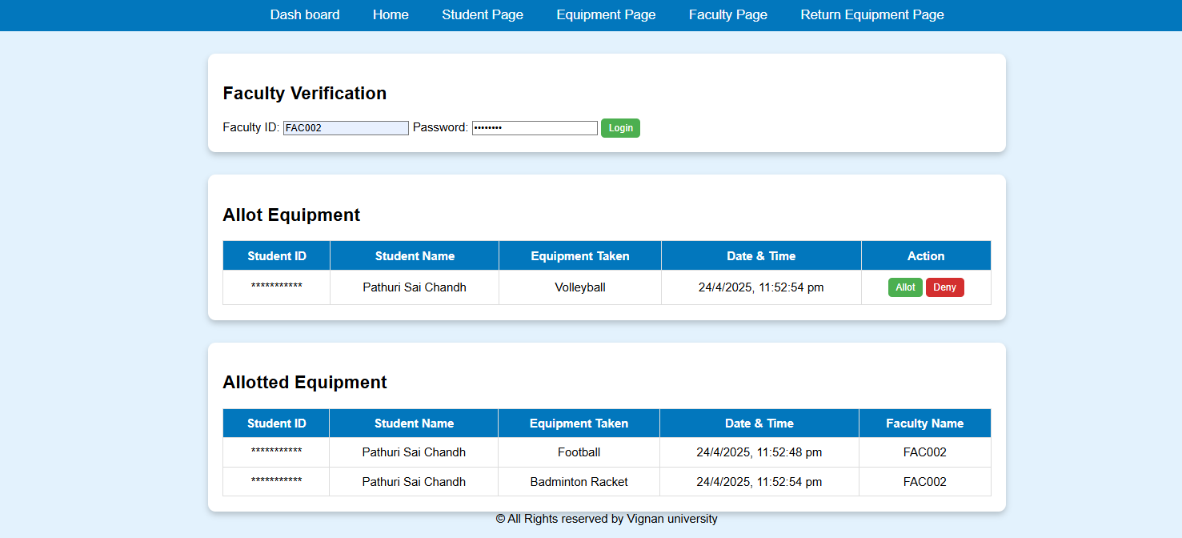
PROJECT PROTOTYPE
STUDENT REGISTRATION
FACULTY APPROVAL

Slide 10
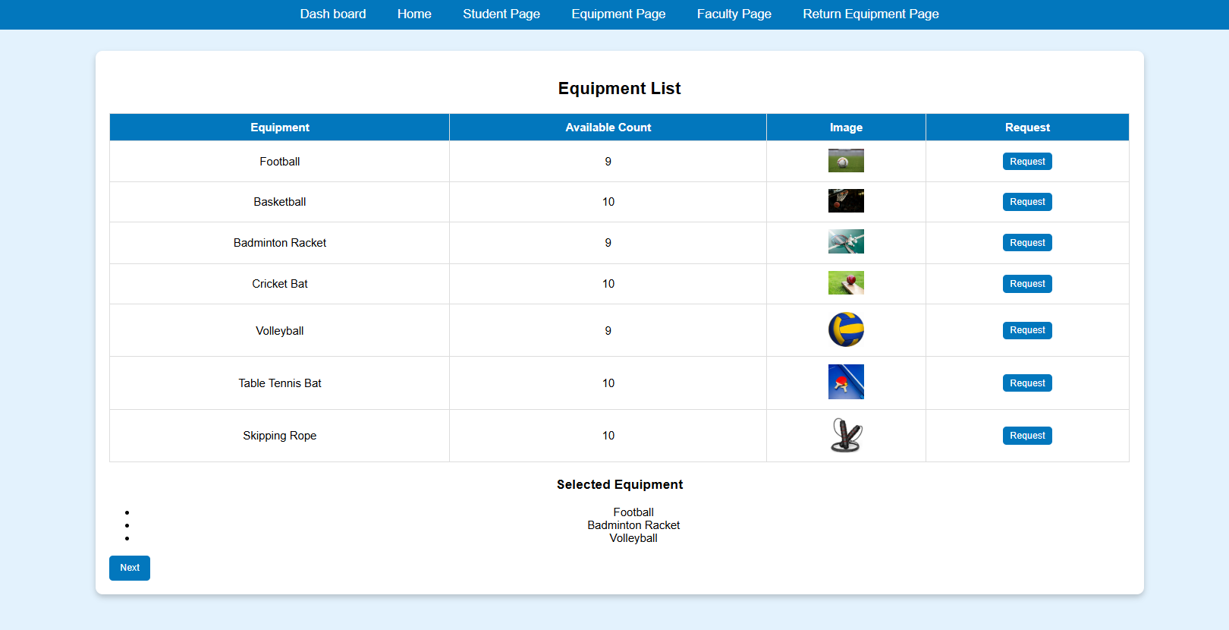
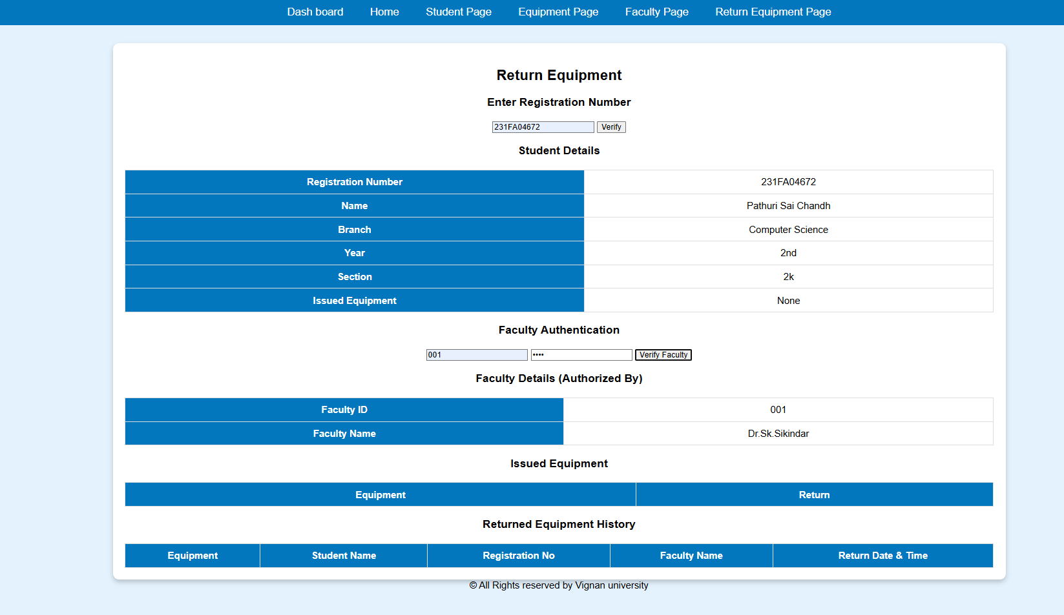
PROJECT PROTOTYPE
INVENTORY RESOURCE
RETURNED INVENTORY
RETURNED INVENTORY

Slide 11
Result
Faster and more organized equipment allocation through a structured request and approval workflow.
Improved accountability and tracking with real-time monitoring of equipment status, usage, and returns.
Reduction in equipment loss and damage by clearly assigning responsibility and maintaining proper logs.
Enhanced user experience for both students and faculty through a simple, transparent, and efficient system.
Data-driven insights to help faculty manage inventory better and plan for future needs.

Slide 12
Conclusion
Our conclusion includes the following future enhancements:
More Equipment Categories
Mobile App Integration
AI-based Equipment Recommendations

Slide 13
Q&A Session

Slide 14
Thank You

